Slide 1

Imaging Edge Transfer App Usability Testing
By Noah Pidding, Camryn Penn, Cyrus Mak, Cater Quartararo

Slide 2
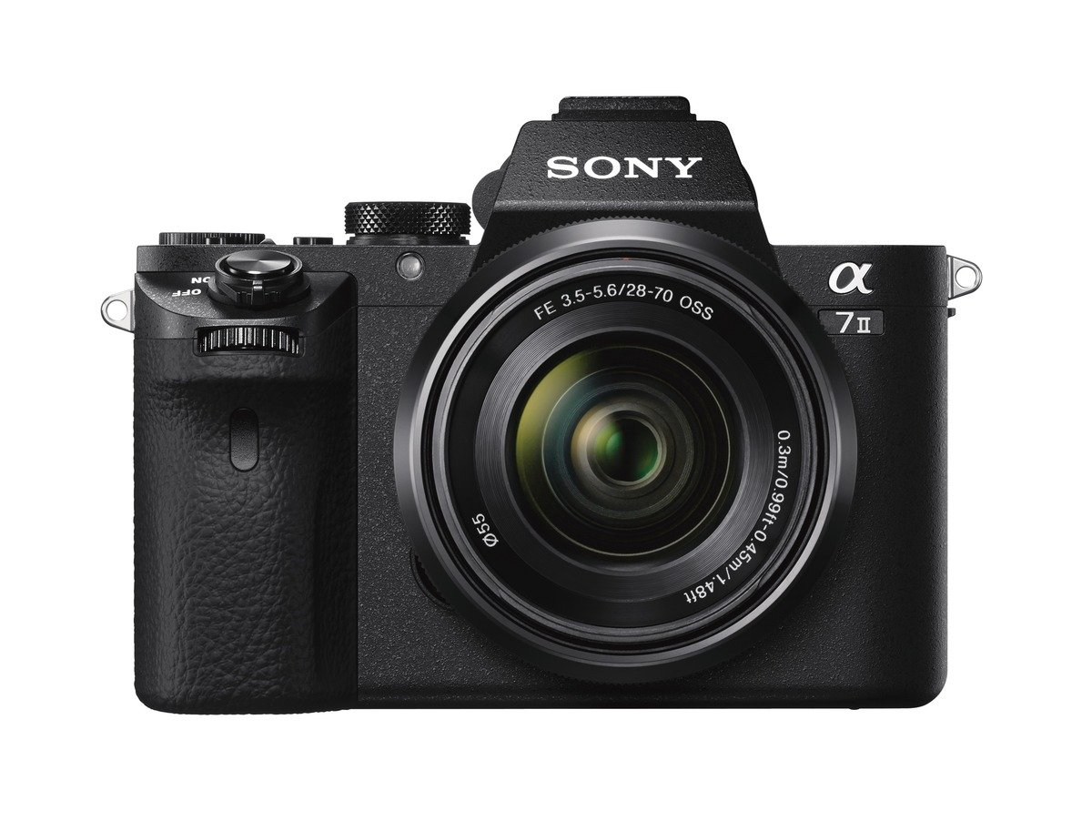

Introduction
Imaging Edge Mobile - app to transfer images (camera -> phone)
Camera model - 7M2
Many opportunities to improve

Slide 3

Methodology
We used TWO consecutive tasks in the app to make up our timed user testing process:
1. Connecting the Camera to the App
2. Uploading an Image from the Camera to the App

Slide 4
Data Collection
Location: University Union
Preliminary Data:
12 Total Tests
Age Range (18-21)
33% had previous camera experience
Metrics Collected:
Time to Complete Process
Error Rate
User Satisfaction
Observations
Time spent within each Phase

Slide 5
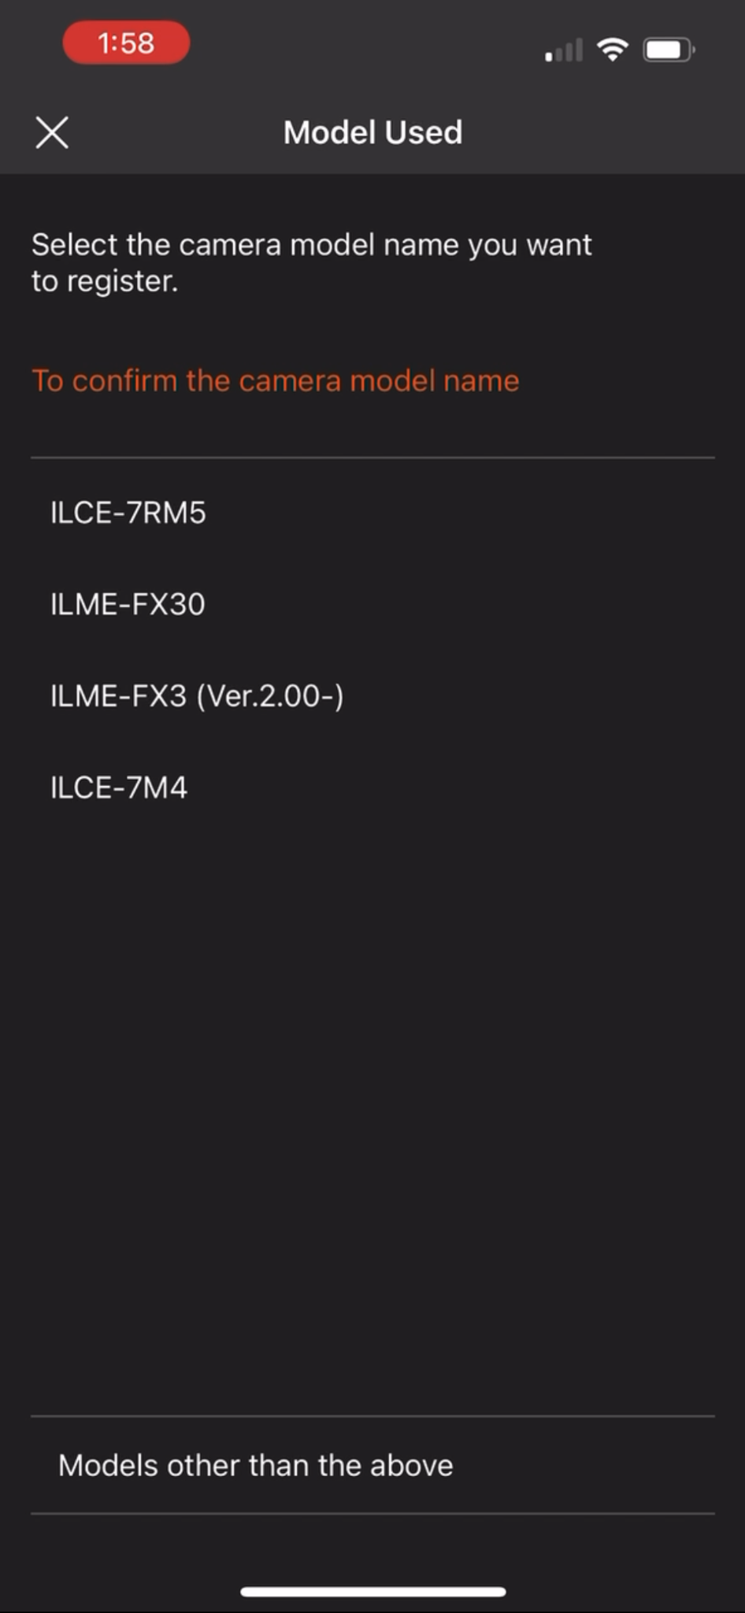
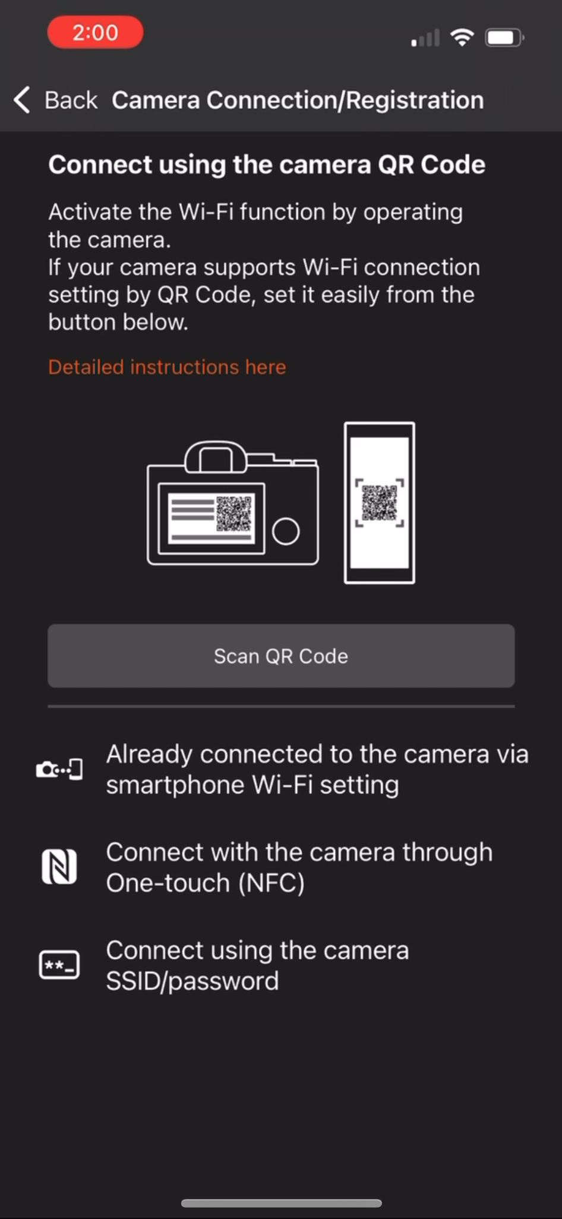
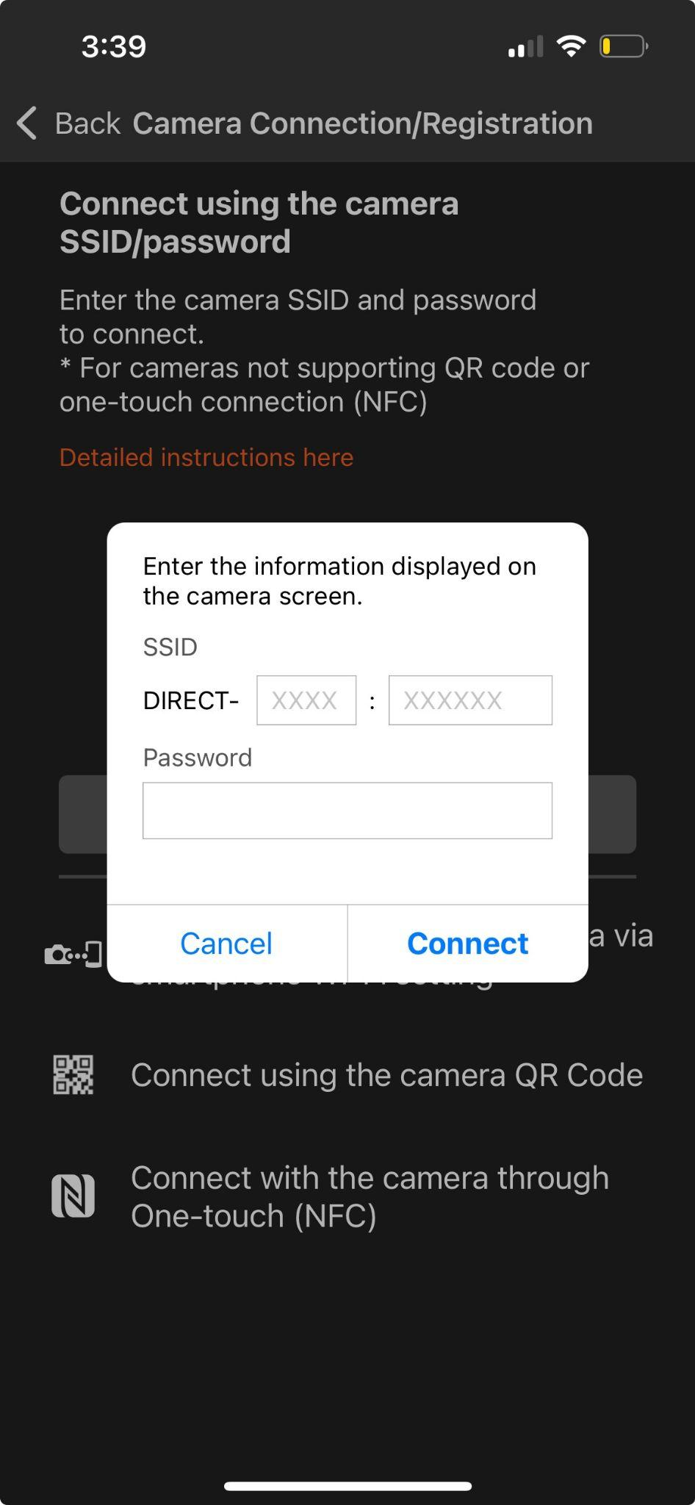
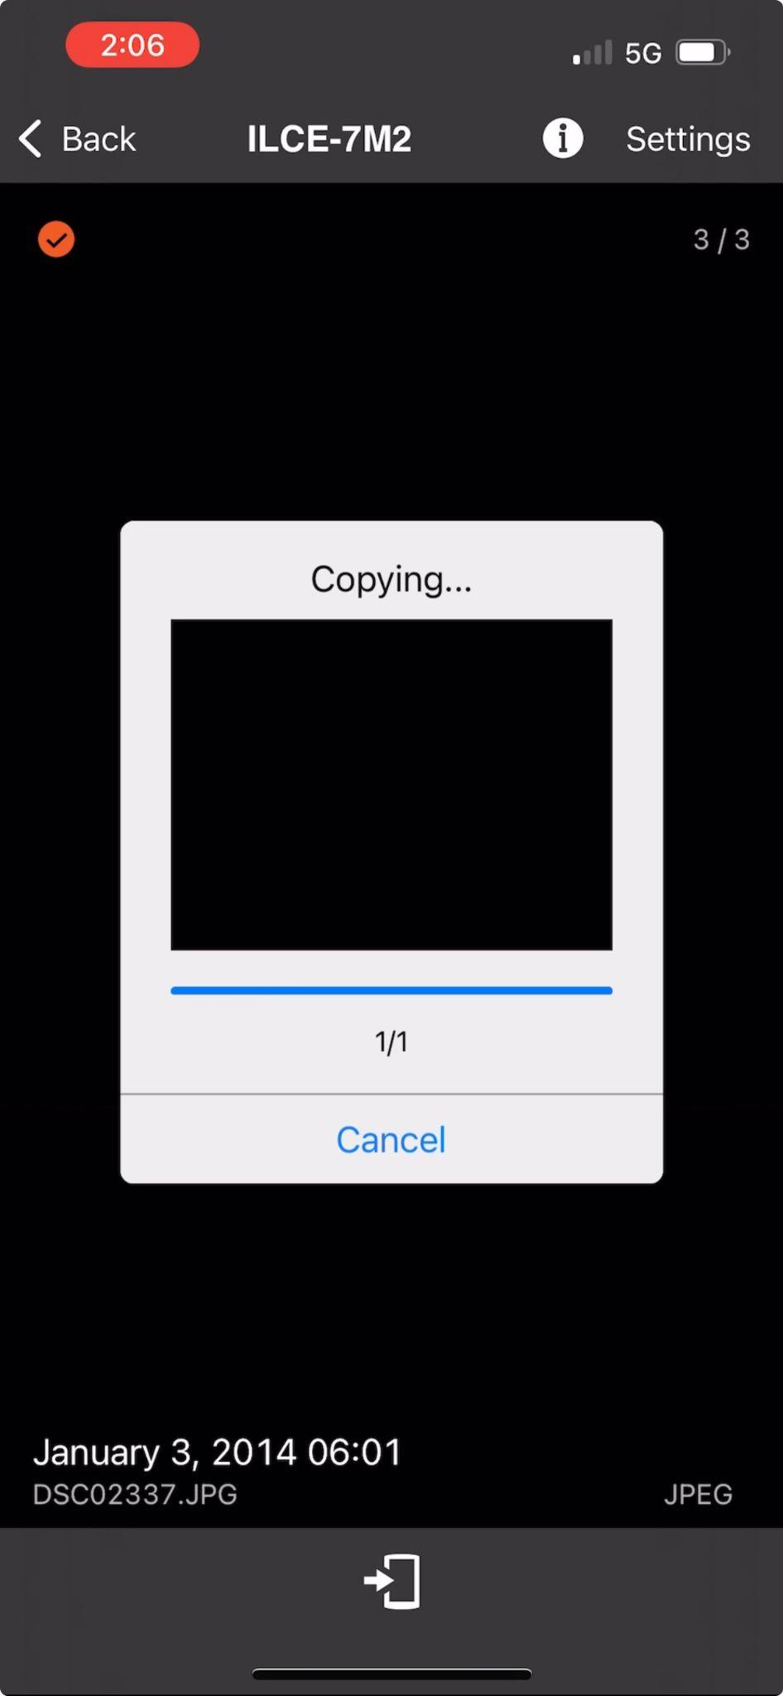
Phase 1
Phase 2
Phase 3
Phase 4

Slide 6
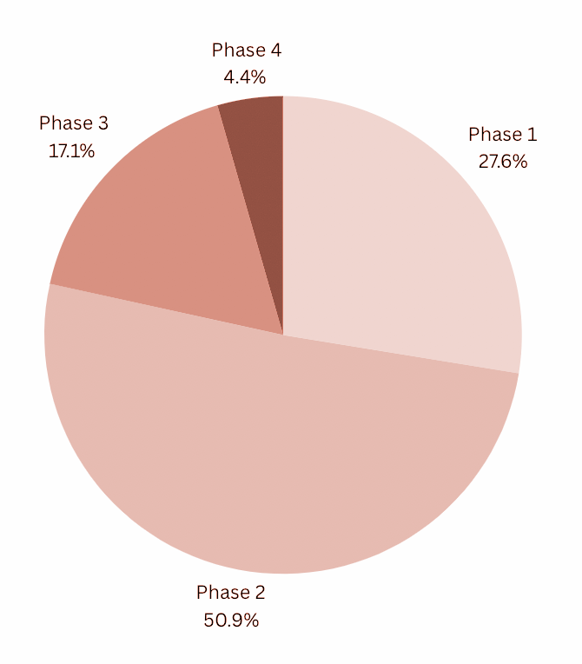
Data - The Four Phases
Phase 1 → Selecting the correct camera option
Phase 2 → Selecting the connection method
Phase 3 → Input the SSID info from the camera into the app
Phase 4 → Successfully transfer a photo from the camera to the phone

Slide 7
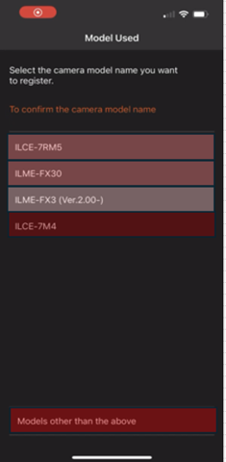
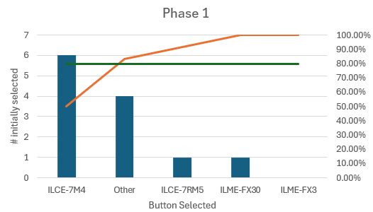
Phase 1
Finding | Recommendation
Essential connection options are placed outside the natural view of users | Move the "models other than above" button to a more prominent position on the screen to improve visibility and accessibility.
Correct Option

Slide 8
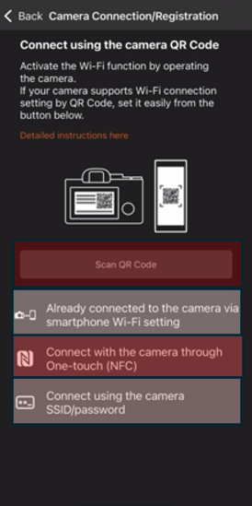
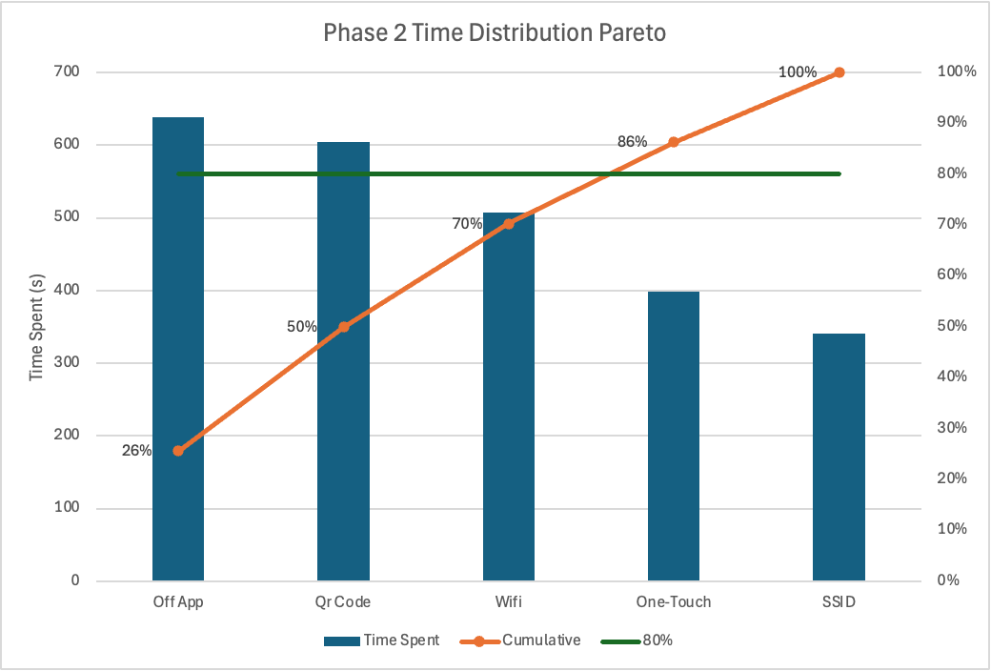
Phase 2
Finding | Recommendation
Connection methods do not work reliably. | Allow user to manually input camera model, then app will suggest optimal method for connection, based on camera model.
Correct Option

Slide 9
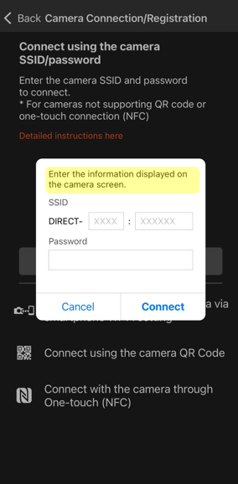
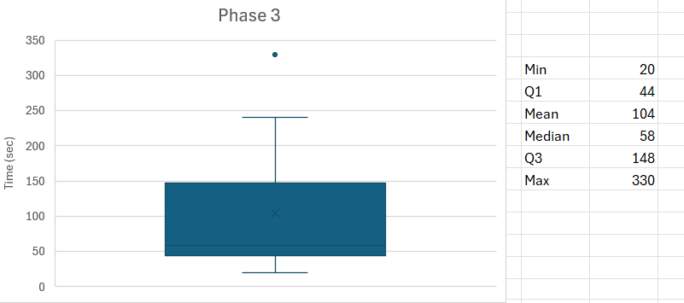
Phase 3
Finding | Recommendation
Where to find SSID info on camera is not clear in app | Provide clear, step-by-step instructions on navigating the camera menu to locate the SSID information needed for connecting and registering the camera.

Slide 10
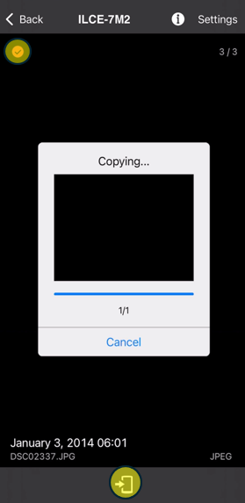
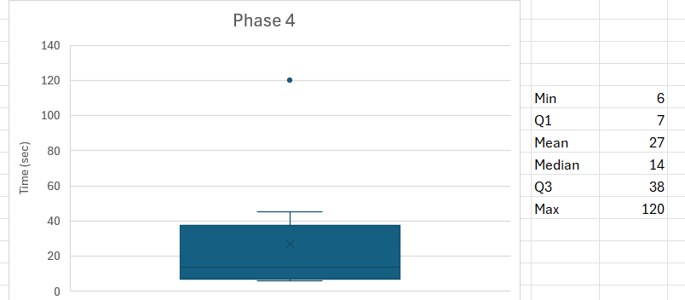
Phase 4
Finding | Recommendation
Button to select image is very small and not initially noticeable: | Increase the size of the image selection circle to make it more noticeable and easier for users to identify when selecting an image.

Slide 11
Conclusion
Key Takeaway:
While the Imaging Edge Transfer app provides essential functionality, major usability issues hinder the overall user experience. The primary pain points involve connectivity stability, workflow efficiency, and error feedback mechanisms.

Slide 12
Thank you!

